Slide 1



OpenCV
Daniil Budanov

Slide 2
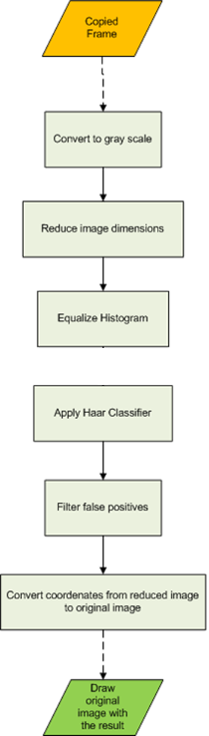

OpenCV
# python code snippets go here
Open Source library for computer vision
Written in C++
Bindings for most popular languages
Block-like programming structure
Image data is sequentially passed through functions
Fundamental concepts allow for powerful image processing tools
import cv2
import numpy as np
codingbox.com
Notes:
This is a broader overview; want to show what blocks are and how they fit in together

Slide 3
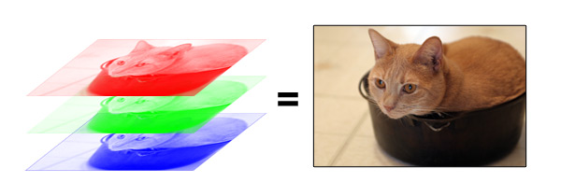
uint8
arrays
Cadin Batrack
img = cv2.imread( ‘image.jpg’) # open image
cv2.imshow( ‘Title’, img ) # show image
cv2.imwrite( ‘image2.jpg’, img ) # write image file
Notes:
Images are simply 3-channel numpy BGR arrays
Take on value 0-255

Slide 4
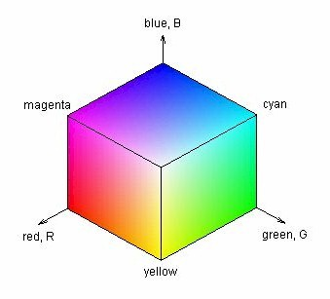
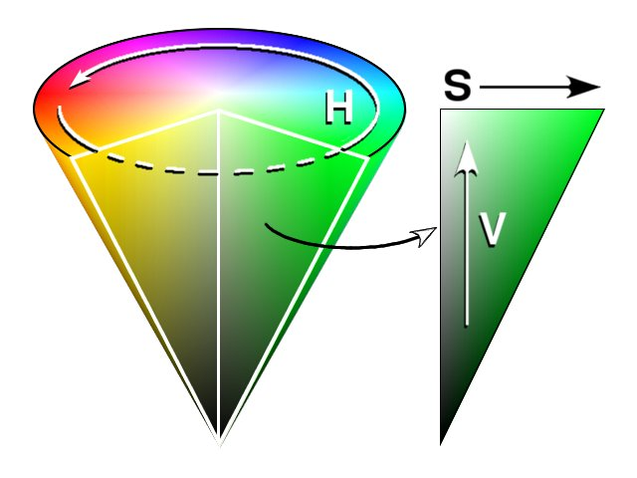

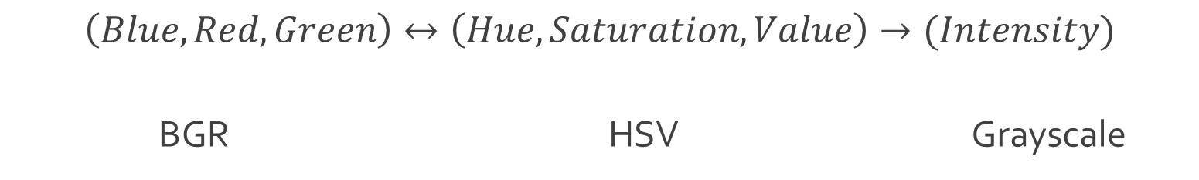
Colorspaces
$$\left(Blue, Red, Green\right)↔\left(Hue, Saturation, Value\right)→(Intensity)$$
BGR | HSV | Grayscale
intensity
img2 = cv2.cvtColor( img, cv2.COLOR_BGR2HSV )
Notes:
Grayscale is useful for assigning function $f\left(x, y\right)$to every pixel
Eg for calculating distance between 2 images’ pixels
Eg for probability that an object centered at that location matches a template
HSV more intuitive than BGR; can be used to find define colors more easily (as long as Hue values known :D )

Slide 5
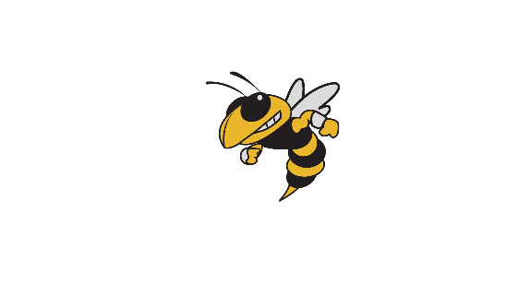
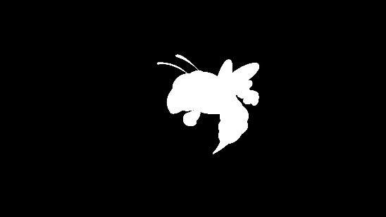
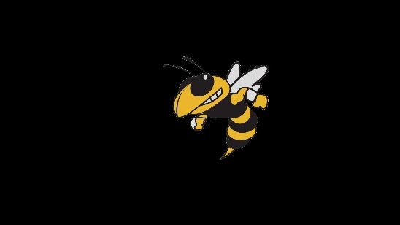
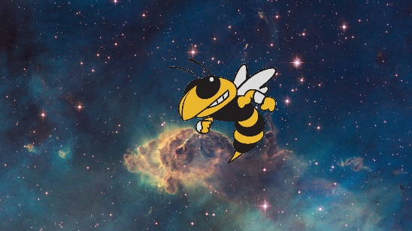
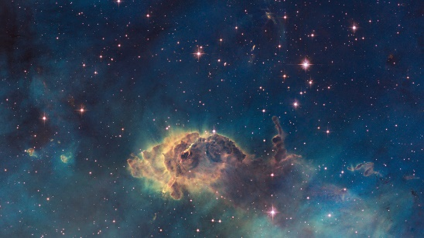
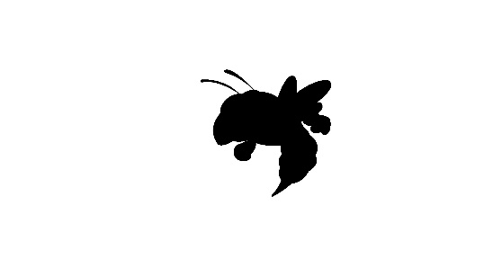
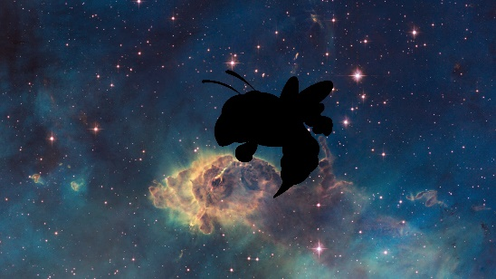
Masking
ret, thresh = cv2.threshold( single_channel, min_value , set_value_to, cv2.THRESH_BINARY )
mask = cv2.inRange( hsv_img, lower_color , higher_color )
cv2.bitwise_and( img, img, mask = mask )
Combine
Image
+
Mask
inRange
threshold
Image
Mask
Binary
operations
Notes:
Use range and thresholding to create logical masks of images
The masks allow regions of different images to be combined together
Binary nature allows for extracting and analyzing shapes from images

Slide 6
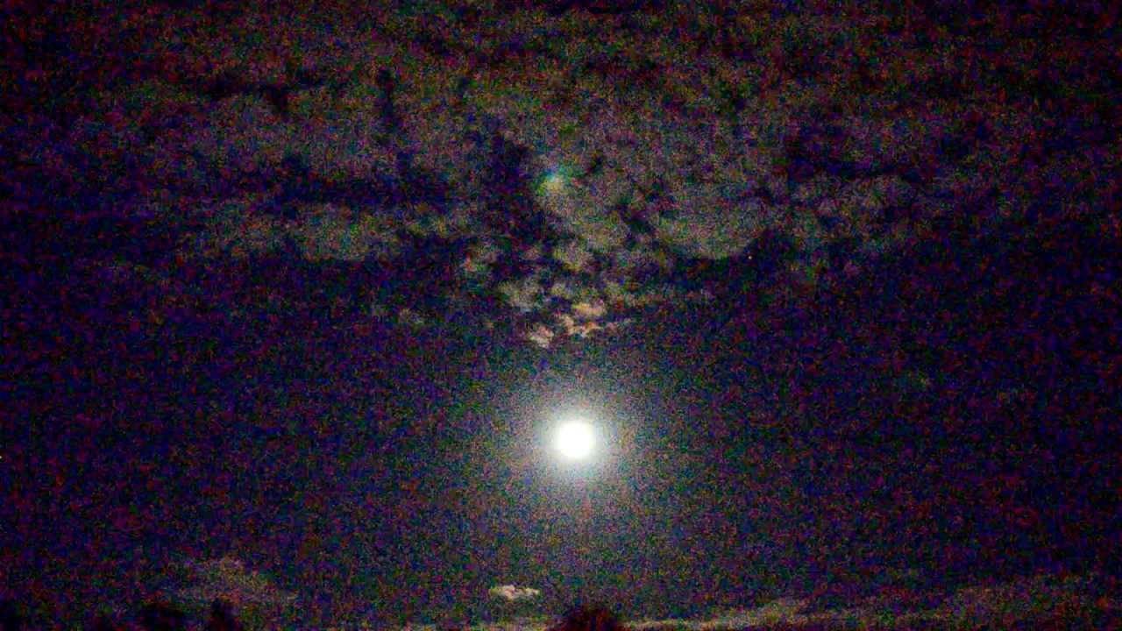
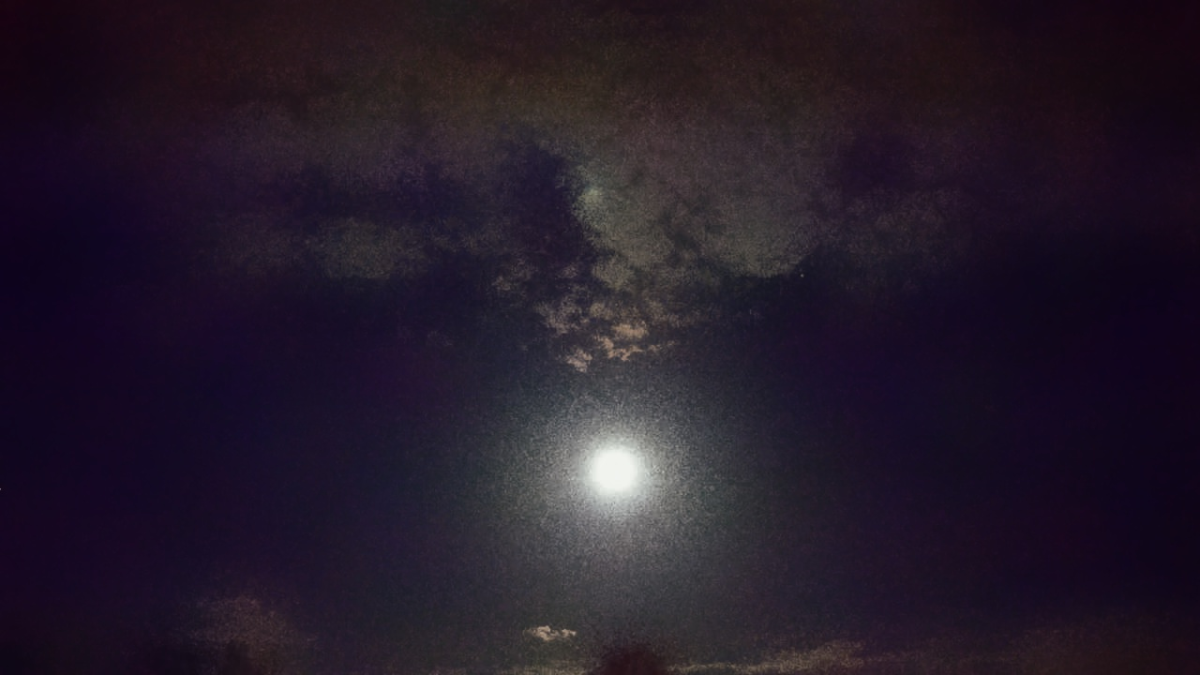
Filtering
Noise Removal (LPF)
Sharpness increase (HPF)
Operate on Kernel

Slide 7
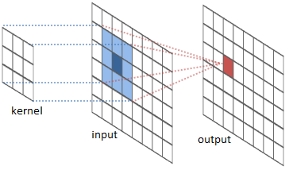
Filtering: Smoothing
Uses 2D Convolution
Blurring removes noise
Kernel size determines blur amount
Types:
Mean - average
Median – less prone to outliers
Gaussian – applies Gaussian curve
Bilateral – blurs & preserves edges
# 5x5 mean filter
kernel = np.ones( ( 5, 5 ) , np.float32 ) / 25
res = cv2.filter2D( img, -1, kernel )
Notes:
Bilateral – applies both a Gaussian and a Gradient to curve
Allows it to both blur and preserve edges
More costly

Slide 8
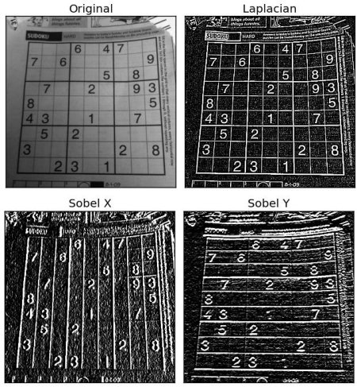
Filtering: Gradients
High Pass Filters
Used to find edges in an image
Specify Kernel size
Types:
Sobel – directional derivatives
Scharr – better for smaller kernel
Laplacian – relation on Sobel derivatives
laplace = cv2.Laplacian( img, cv2.CV_64F )
sobelX = cv2.Sobel( img, cv2.CV_64F, 0, 1, ksize = 5 )
OpenCV Documentation
Notes:
Useful for detecting edges of image

Slide 9
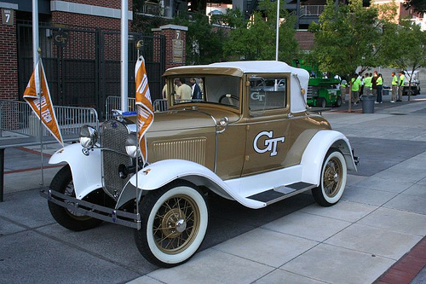
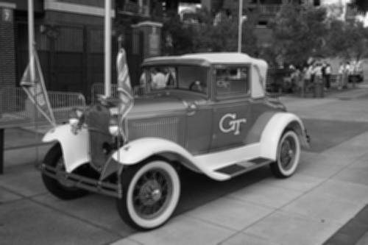
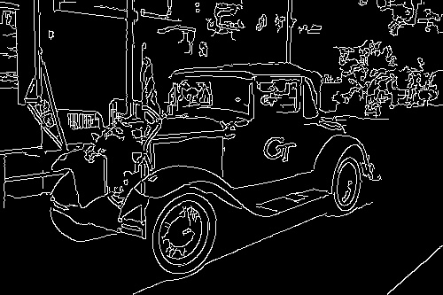
Gradients for Canny Edge Detection
# 4x4 mean filter
kernel = np.ones( ( 4, 4 ) , np.float32 ) / 16
wreck= cv2.filter2D( img, -1, kernel )
# apply canny edge detection
edges = cv2.Canny( wreck, 0, 200 )
Original
Smoothed
Canny
Notes:
more elaborate algorithm to find edges of object
gives a binary mask of edges
issue: want to do computations on objects in image
BUT this is only a map of pixels; the edges don’t have to form closed object
similar to contrasting surface (frontier) with manifold boundary in Calc III
one is just a set of points; the other is a mathematical object (representation)
that can be operated on

Slide 10
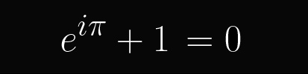
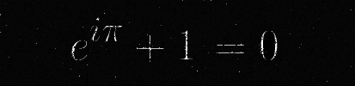
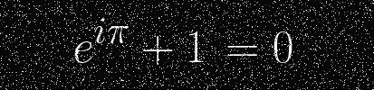
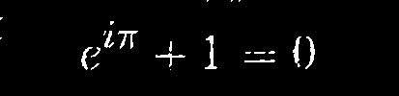
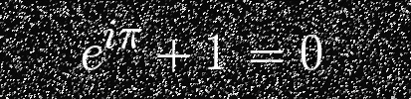
Filtering: Morphological Transformations
kernel = np.ones( ( 5, 5 ) , np.float32 ) / 25
erosion = cv2.erode( img, kernel, iterations = 1 )
dilation = cv2.dilate( img, kernel, iterations = 1 )
opening = cv2.morphologyEx( img, cv2.MORPH_OPEN, kernel )
closing = cv2.morphologyEx( img, cv2.MORPH_CLOSE, kernel )
Original
Erosion
Combination
Noisy Image
Dilation
Notes:
Fundamental Transformations:
Erosion – if all neighbors = 1, lives; dies otw
Dilation – if any neighbor = 1, lives; if none on, dies
Combine for better results
Open – Erode, then Dilate
Close – Dilate, then Erode
Use for noise removal and connecting/disconnecting shapes
relate binary maps: masks + edges + morph transf

Slide 11
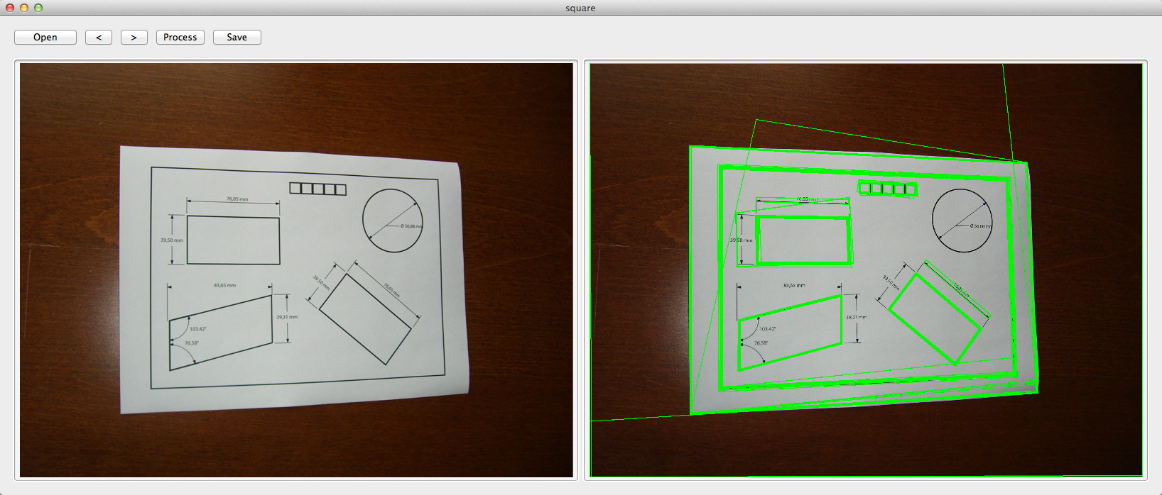
Contours
Join all continuous points along boundary
Detect from logical mask
Contour hierarchies allow selection of a contour based on its relation to others
img2, contours, hierarchy = cv2.findContours( mask, cv2.RETR_TREE, cv2.CHAIN_APPROX_SIMPLE )
cv2.drawContours( img, contours, contour_number, ( 0, 255, 0 ), thickness )

Slide 12
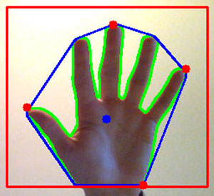
Contour Functions
Contours can be mathematically analyzed
OpenCV functions give:
Moments & Centroids
Area & Perimeter
Convex hulls
Bounding Rectangles
Fit curves & shapes
Outermost points
Shape Matching

Slide 13
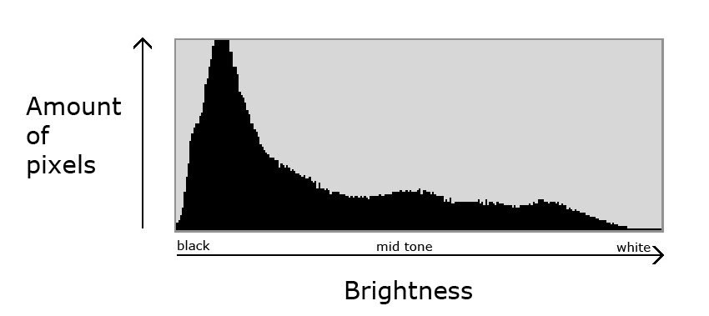

Histogram: $intensity→frequency$
juzaphoto
hist = cv2.calcHist( [img], [channel], mask, [number_bins], [min_val, max_val] )
Notes:
Histograms plot color intensity vs frequency
Are a powerful tool for optimizing and tracking colors in CV
--
relate pixel to entire image
allow us to look at image on broader terms

Slide 14
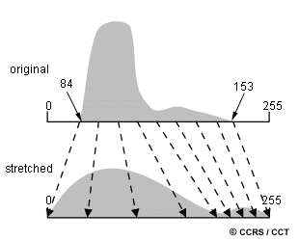
Histogram Equalization
Notes:
Calculate probability of pixels in peak range, redistribute throughout whole range

Slide 15
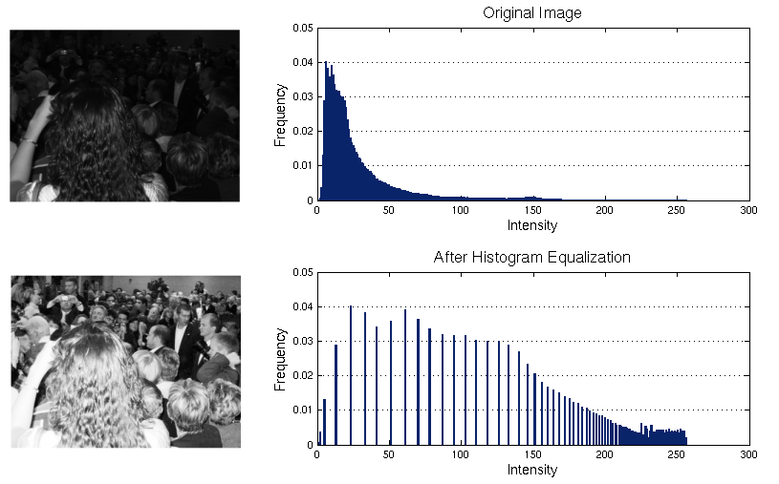
eq = cv2.equalizeHist( img )
James Fishbaugh
Notes:
Effective for improving contrast of image
Works best on single-peak/single-range images

Slide 16
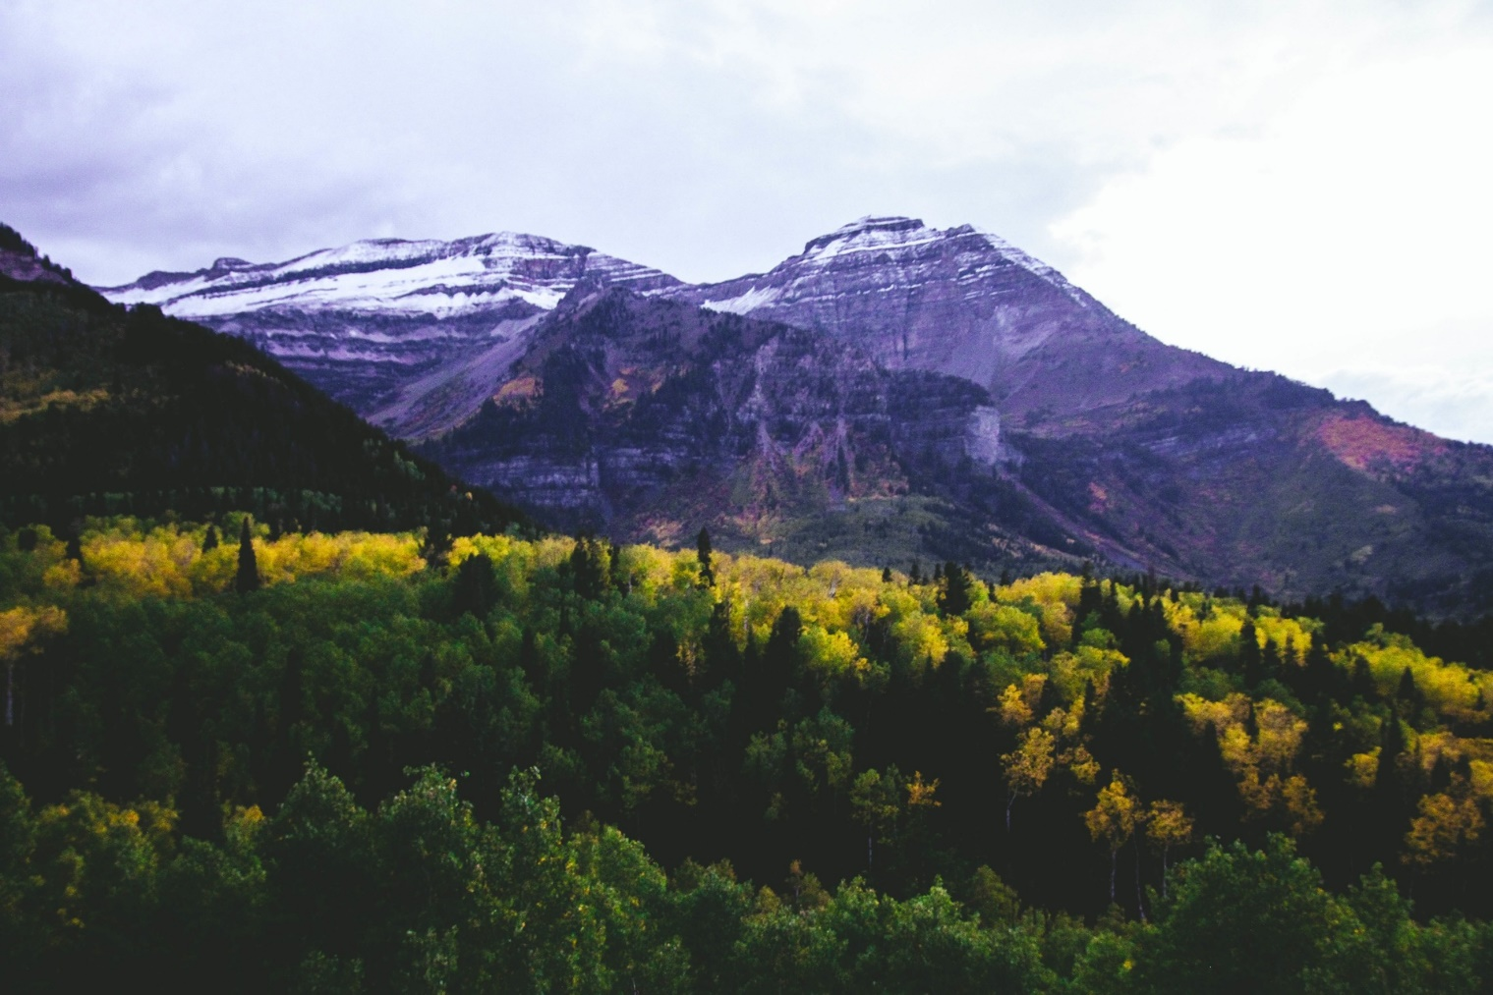
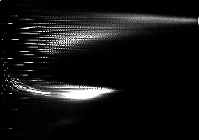
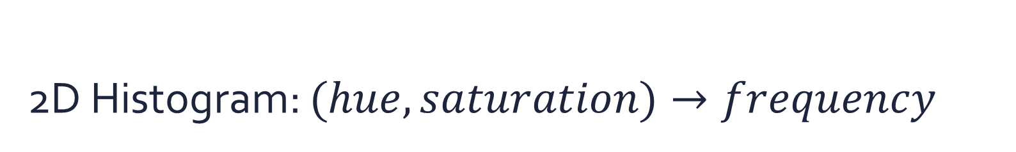
2D Histogram: $(hue, saturation)→frequency$
Hue
frequency
Saturation
hist = cv2.calcHist( [img], [0, 1], mask, [180, 256], [0, 180, 0, 256] )
Notes:
explain, piggybacking off of HSV slide

Slide 17
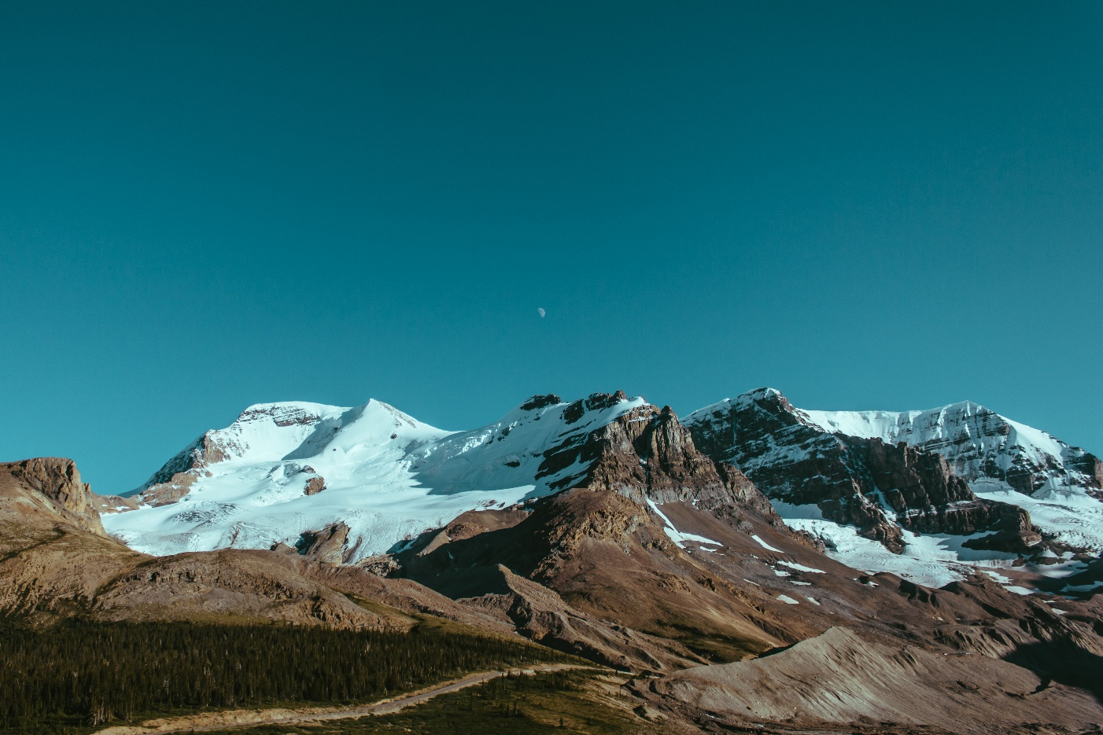
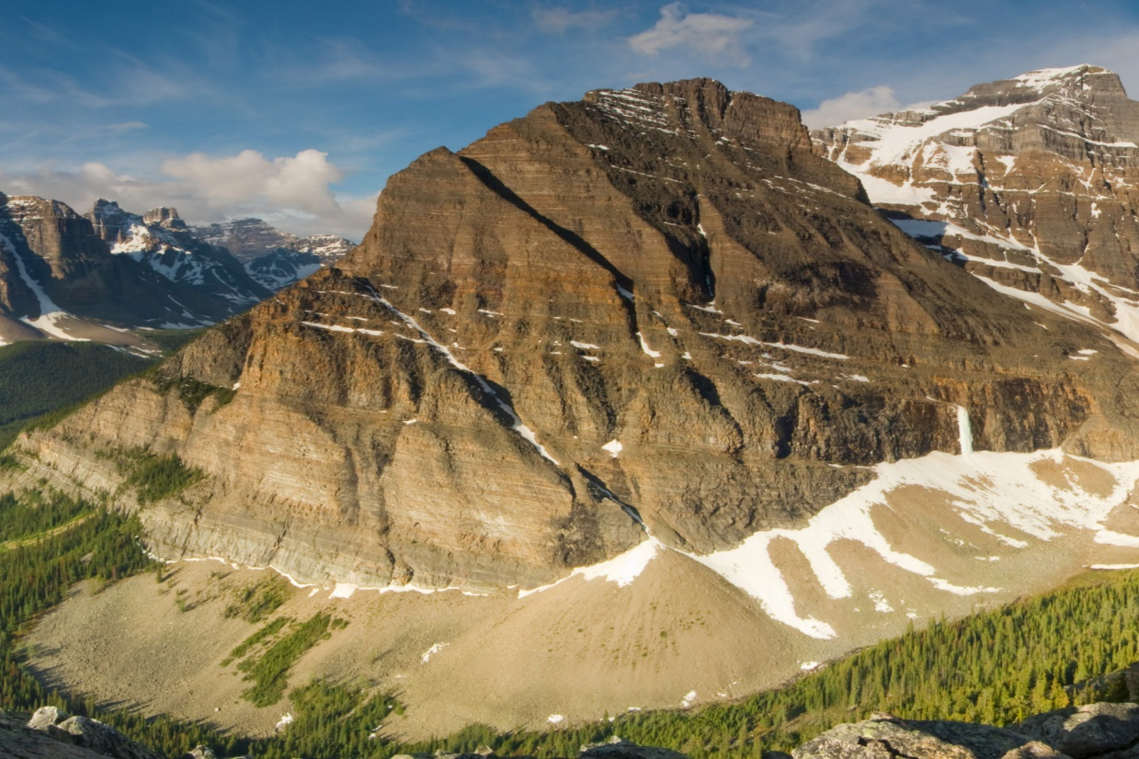
Histogram Backprojection
Returns similarity of pixels in image region to the histogram
Useful for object detection
Find similar mountains
Example of a mountain

Slide 18

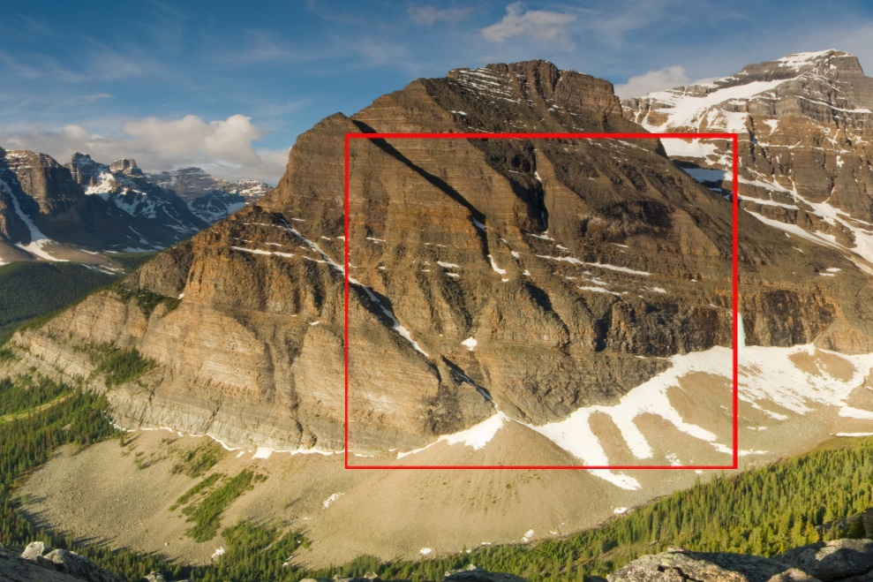
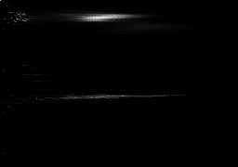

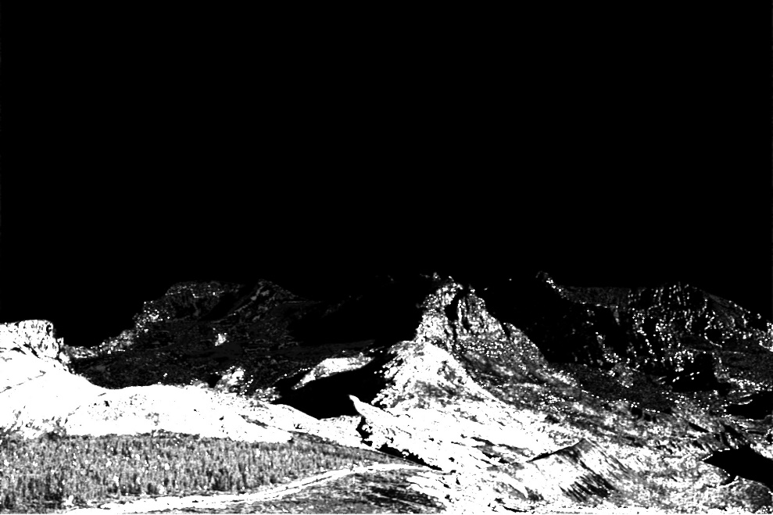
Calculate
region histogram
Select region
create into mask
Back project
Distance
mapping
Notes:
ex. drone can analyze video on the fly

Slide 19
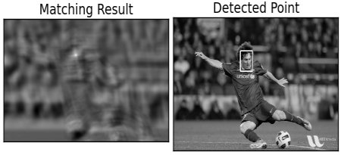
Template Matching
Given template, scans through image
Returns map of the correlation between template and pixel region
OpenCV Documentation
dst = cv2.matchTemplate( img, template, cv2.TM_COEFF_NORMED )
min_val, max_val, min_arg, max_arg = cv2.minMaxLoc( dst )

Slide 20
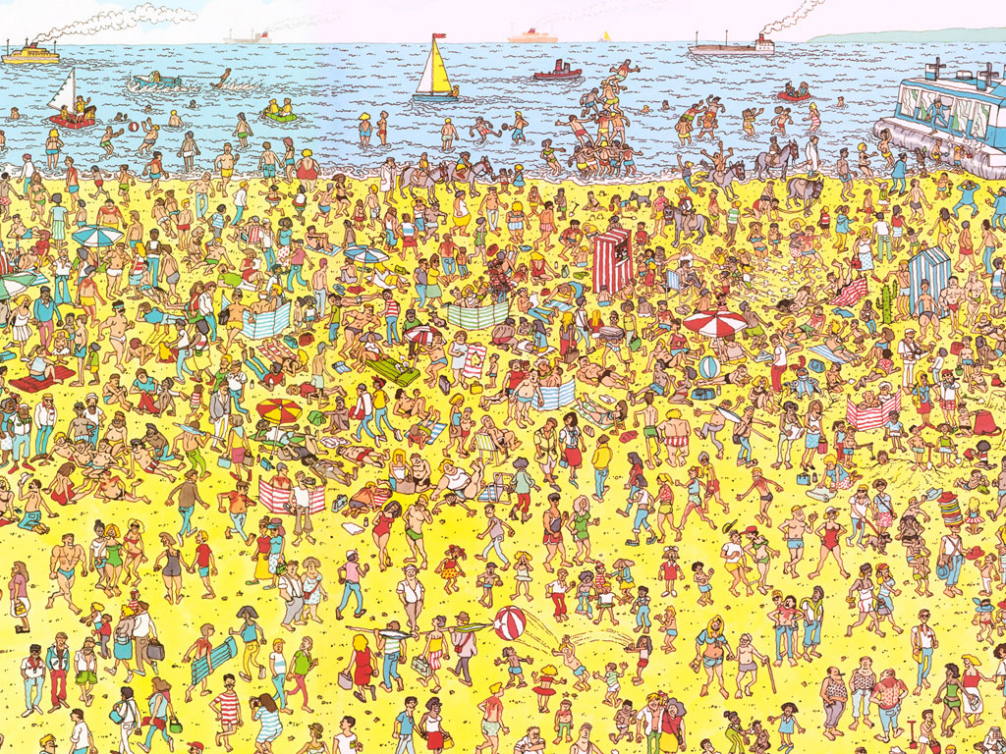
Notes:
shows that there exist more advanced concepts req. more complex algorithms

Slide 21
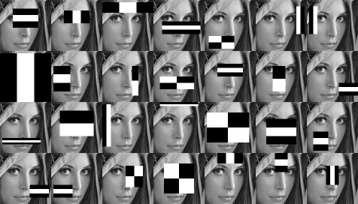
Haar Cascades & Classifiers
Notes:
First, machine learning techniques are used to train the classifiers from a dataset
Commonly used cascades available with OpenCV library
Then, a cascades technique rapidly analyzes an image
Essentially, takes points with a classifier and discards all without it
Yields points pertaining to classifiers
Useful in face and object detection etc.

Slide 22
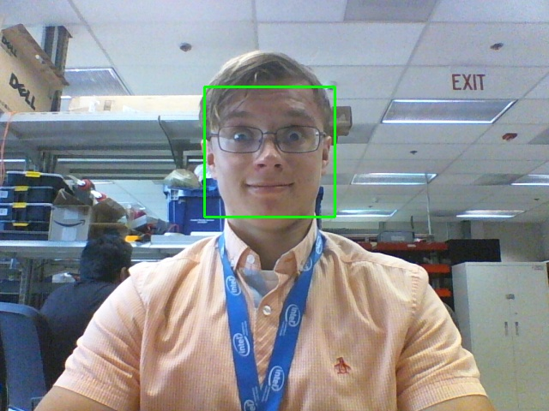
cascade = cv2.CascadeClassifier( ‘haarcascade_frontalface_default.xml’ )
gray_img = cv2.cvtColor( img, cv2.COLOR_BGR2GRAY )
faces = cascade.detectMultiScale(
gray_img,
scaleFactor = 1.25,
minNeighbors = 5,
minSize = ( 30, 30 ),
)
for (x, y, w, h) in faces:
cv2.rectangle( img, x, y, (x+w, y+h), (0, 255, 0), 2)

Slide 23
Examples

Slide 24
Crosshair follows object of distinct color
Set
Mouse
callbacks
Color
Range
Trackbars
Capture
Video from
Webcam
Convert frame to HSV
Mask colors in range
Morph. close mask to fill holes
Find contours
Find largest contour
Find centroid
Draw crosshair on centroid

Slide 25
Backproject selected region
Region
Select Callback
Capture
Video from
Webcam
Convert frame to HSV
Calculate hist of selected region
Backproject onto frame
Open region
Bitwise mask
Filter backprojection
Display
Results
Apply
Proximity
colormap
Notes:
More sophisticated way of tracking color, as tracks histogram instead

Slide 26
Modularity: using an online video stream
Video capture from online webcam
Load video URL
Start stream
Do whatever processing is necessary
Parse stream
Decode to frame
Notes:
Frame-based analysis of video allows us to generate our own video streams
The while loop going over each frame allows us to utilize the frames from these streams

Slide 27
Presence detection from an online camera
Click to capture empty room
Capture online
video
Generate frame buffer
Take image of empty room
Take distance between current and empty pixels
Take threshold of distances
Dilate map to close holes
Find contours
Find contour of largest area
Update buffer
If buffer is full, draw contours
Display video

Slide 28
Storing video upon face detection
Capture
Video from
Webcam
Generate buffer
Create cascade classifier from Haar Cascade
Convert color to grayscale
Generate video writer
Create face detection cascade
Draw rectangle around faces
Wait until buffer ends
Video saved to file

Slide 29
# See:
# http://docs.opencv.org/3.1.0/d6/d00/tutorial_py_root.html
# for excellent tutorials and explanations

